Slide 1
Crowdsourcing for Sentiment Analysis
Advanced Internet Computing Topic 2
Group 6
Richard Bayerle 1025259
Peter Klein 8251105
Alexander Kumbeiz 1228689

Slide 2
Objective
Rating the sentiment of the public on companys, organizations and products
Sentiment changes fast -> cannot be based on historic analysis
Requires analysis of unstructured information -> makes it hard for machines to solve
Requires commonsense knowledge
Excellent task for crowdsourcing

Slide 3
Problem Solving Strategy
Search
Receive the topic searched for and identify related topics
Search for articles published recently on the topic
Distribute
Assign articles to tasks for human workers in crowdsourcing platform
Wait for the human workers to perform their tasks
Collect & Rate
Collect the results
Combine them to a common sentiment rating
Display the rating

Slide 4
Architecture
topic
rating
rating of task
Sentiment Analysis
Application
tasks
Crowd Platform
(Mock)
results
related
topics
articles
DbPedia
Yahoo

Slide 5
Datamodel
Task
callbackurl
description
text
title
url
workercount
Article
url
date
text
title
Rating
id
value
article
1 n
n
m
1
n
Job
id
date
name
state
Answer
id
answer
taskid

Slide 6
Technologies
Java/J2EE based
Tomcat as Servlet Container
JPA for database connectivity
Eclipselink as JPA Provider
SQLite database
REST style webservices between Crowd, Mock and GUIs
AngularJS (with Restangular) as GUI
Twitter-Bootstrap as HTML5 Template

Slide 7
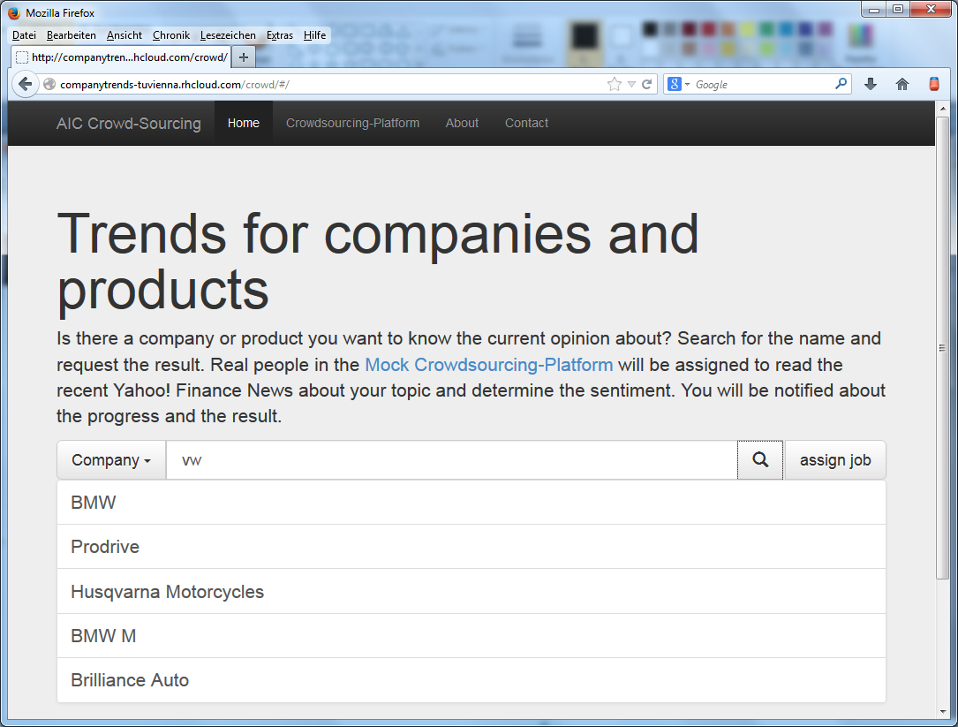
Presentation
Deployed on http://companytrends-tuvienna.rhcloud.com/crowd
→ Enjoy the presentation

